Slide 1

323
RA
325
Campus Center
Elevator
Laundry
Trash
327
329
331
333
335
Lounge
Tech
Suite
313
Single Use Restrooms
Multi-Use Restroom
330
332
334
336
338
340
311
309
Multi-Use Restroom
Double
307
Single
Messenger Hall
3rd floor
305
312
303
310
308
306
Tech
Suite
Lounge
304
Quad

Slide 2
423
RA
425
Campus Center
Elevator
Laundry
Trash
427
429
431
433
435
437
Lounge
Tech
Suite
413
Single Use Restrooms
430
432
434
436
438
440
442
Multi-Use Restroom
411
409
Multi-Use Restroom
407
Double
Single
Messenger Hall
4th floor
405
412
403
410
408
406
Tech
Suite
Lounge
404
Quad

Slide 3
523
RA
525
Campus Center
Elevator
Laundry
Trash
527
529
531
533
535
537
Lounge
Tech
Suite
513
Single Use Restrooms
530
532
534
536
538
540
542
Multi-Use Restroom
511
509
Multi-Use Restroom
507
Double
Single
Messenger Hall
5th floor
505
512
503
510
508
506
Tech
Suite
Lounge
504
Quad

Slide 4

Founders Hall
4th floor
413
409
D
C
B
406
L
411
D
C
A
B
402
C
B
L
RA
B
L
408
D
C
C
A
D
A
L
A
L
B
404
A
B
L
C
D
414
412
C
A
L
L
RA
B
L
L
A
C
C
D
L
A
A
B
A = Bedroom
B = Bedroom
C = Bedroom
D = Bedroom
L = Living Area
RA = Resident Assistant
410
S
C
D
C
C
S
B
407
401
D
D
403
Boynton Street - Facing Library

Slide 5
Institute Rd.
= 5 Person
1 Double, 1 Triple
6
7
8
9
1
RA
= 7 Person
2 Doubles, 1 Triple
2
Trowbridge Rd.
Einhorn Rd.
3
14
15
16
RA
4
11
13
10
12
5
Ellsworth Apartments

Slide 6
Institute Rd
2
RA
16
RA
1
15
3
4
17
18
5
6
19
Trowbridge Rd.
= 2 Person Studio
Schussler Rd
7
8
21
22
= 3 Person Studio
9
23
24
= 5 Person
1 Double, 1 Triple
11
12
25
26
= 7 Person
2 Doubles, 1 Triple
13
14
Fuller Apartments

Slide 7
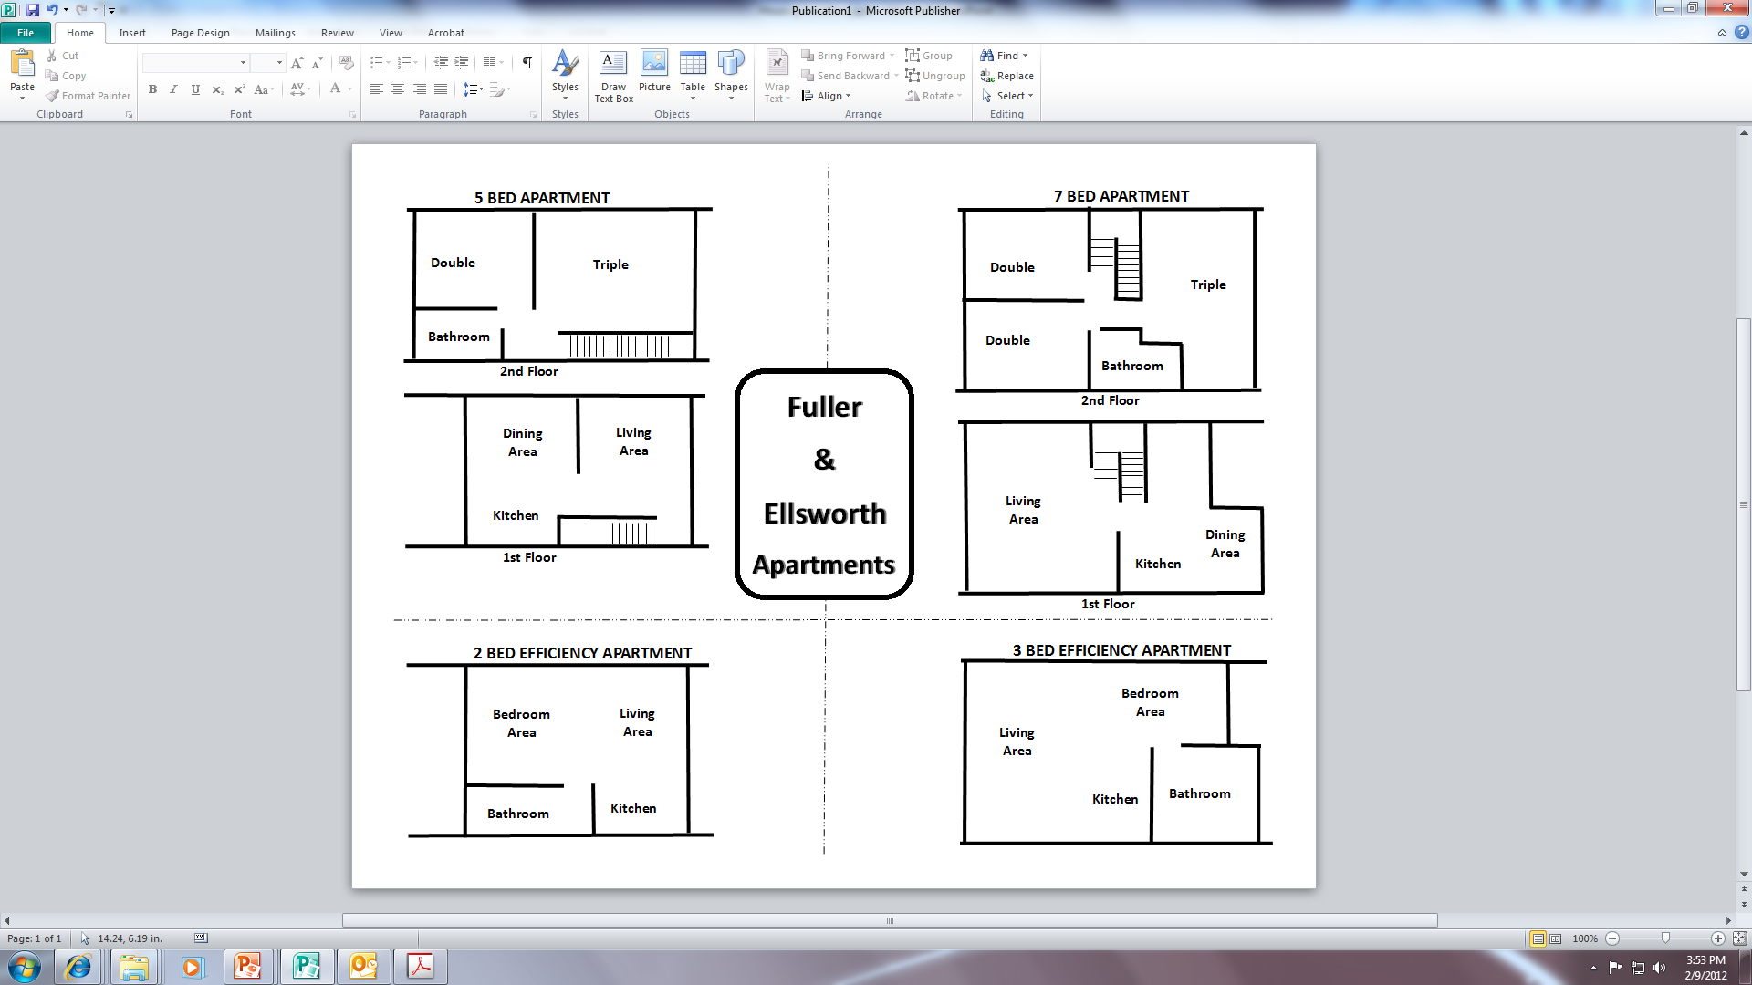
5 Person Apartment
7 Person Apartment
Fuller/
Ellsworth
Floorplan
2 Person Studio
3 Person Studio
5 BED APARTMENT
7 BED APARTMENT
Double
Triple
Double
Triple
Bathroom
Double
2nd Floor
Bathroom
Fuller
&
Ellsworth
Apartments
2nd Floor
Dining
Area
Living
Area
Living
Area
Kitchen
Dining
Area
1st Floor
Kitchen
1st Floor
2 BED EFFICIENCY APARTMENT
3 BED EFFICIENCY APARTMENT
Bedroom
Area
Bedroom
Area
Living
Area
Living
Area
Kitchen
Bathroom
Bathroom
Kitchen

Slide 8
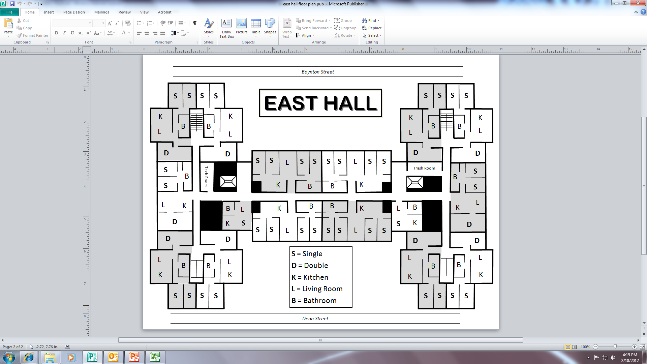
205
206
East Hall
2nd floor
216
215
207
208
204
214
201
RA
211
209
210
S = Single
D = Double
L = Living Area
K = Kitchen
B = Bathroom
203
202
212
213

Slide 9
305
306
East Hall
3rd floor
316
315
307
308
304
314
301
311
RA
309
310
S = Single
D = Double
L = Living Area
K = Kitchen
B = Bathroom
303
302
312
313

Slide 10
405
406
East Hall
4th floor
416
415
407
408
404
414
401
RA
411
409
410
S = Single
D = Double
L = Living Area
K = Kitchen
B = Bathroom
403
402
412
413

Slide 11
505
506
East Hall
5th floor
516
515
507
508
504
514
501
511
RA
509
510
S = Single
D = Double
L = Living Area
K = Kitchen
B = Bathroom
503
502
512
513

Slide 12
Faraday St.
111
113
115
117
L
A
B
C
L
A
B
C
L
A
B
C
L
A
B
C
K
K
K
K
Bathroom
Bathroom
Bathroom
Bathroom
Laundry Room
K
Bathroom
K
Bathroom
K
Bath
C
C
Lancaster St.
Men’s & Women’s Restrooms
Studio
L
A
B
L
A
B
Main Entrance
112
RA
114
116
L
K
K
L
124 (ADA)
A
A
123 (ADA)
Lobby/Lounge
B
B
C
Bath
Bath
C
Faraday Hall
1st floor
Grove St.
Multi-Purpose Room
L
K
K
L
126
A
A
125
B
Bathroom
Bathroom
B
C
C
A = Bedroom
B = Bedroom
C = Bedroom
L = Living Area
K = Kitchen
K
L
A
127
Bathroom
B
C

Slide 13
Faraday St.
211
213
215
217
L
A
B
C
L
A
B
C
L
A
B
C
L
A
B
C
K
K
K
K
Tech Suite
Bathroom
Bathroom
Bathroom
Bathroom
Tech Suite
K
Bath
K
Bathroom
K
Bathroom
Bath
221
C
C
Studio
205
L
Studio
L
A
B
L
A
B
K
Lancaster St.
A
K
212
RA
214
216
L
K
K
L
B
K
Bathroom
L
A
A
223 (ADA)
C
Bathroom
A
224 (ADA)
B
L
B
203
K
B
206
A
C
Faraday Hall
2nd floor
C
Bath
Bath
C
B
Grove St.
K
Bathroom
L
L
K
K
L
C
Bathroom
A
L
226
A
A
201
K
B
204
B
Bathroom
Bathroom
225
A
C
B
B
K
C
C
Bathroom
L
C
Bathroom
A
A = Bedroom
B = Bedroom
C = Bedroom
L = Living Area
K = Kitchen
228
K
K
L
B
202
Studio
Bath
A
C
227
Bathroom
B
C

Slide 14
Faraday St.
311
313
315
317
L
A
B
C
L
A
B
C
L
A
B
C
L
A
B
C
K
K
K
K
Tech Suite
Bathroom
Bathroom
Bathroom
Bathroom
Tech Suite
K
Bath
K
Bathroom
K
Bathroom
Bath
321
C
C
Studio
305
L
Studio
L
A
B
L
A
B
K
Lancaster St.
A
K
312
RA
314
316
L
K
K
L
B
K
Bathroom
L
A
A
323 (ADA)
C
A
324 (ADA)
Bathroom
B
B
L
B
306
303
A
K
C
C
C
Faraday Hall
3rd floor
Bath
Bath
Grove St.
B
K
Bathroom
L
L
K
K
L
C
Bathroom
A
L
326
A
A
325
301
K
B
304
B
Bathroom
Bathroom
A
C
B
B
K
C
C
Bathroom
L
C
Bathroom
A
A = Bedroom
B = Bedroom
C = Bedroom
L = Living Area
K = Kitchen
328
K
K
L
B
302
Studio
Bath
A
C
327
Bathroom
B
C

Slide 15
Faraday St.
411
413
415
417
L
A
B
C
L
A
B
C
L
A
B
C
L
A
B
C
K
K
K
K
Tech Suite
Bathroom
Bathroom
Bathroom
Bathroom
Tech Suite
K
Bath
K
Bathroom
K
Bathroom
Bath
421
C
C
Studio
Lancaster St.
405
L
Studio
L
A
B
L
A
B
K
A
K
L
K
K
L
B
K
412
RA
414
416
Bathroom
L
A
A
423 (ADA)
C
A
424 (ADA)
Bathroom
B
B
403
L
B
406
K
C
A
C
Faraday Hall
4th floor
C
Bath
Bath
Grove St.
B
K
Bathroom
L
L
K
K
L
C
Bathroom
A
401
L
B
426
A
A
425
A
K
404
B
Bathroom
Bathroom
B
C
B
K
C
C
Bathroom
L
C
Bathroom
A
S = Single
D = Double
L = Living Area
K = Kitchen
428
K
K
L
B
402
Studio
Bath
A
C
427
Bathroom
B
C

Slide 16
Salisbury Estates
Please note:
Due to renovations and upgrades to student apartments at Salisbury Estates planned for summer 2020, the exact apartment addresses are not yet available for housing selection. The apartments available will be in the units closest to Institute Park and have been assigned generic numbers 1-15. Students who select into Salisbury Estates will receive more specific information about their housing assignments from Residential Services this summer.
All Salisbury Estates apartments have the same setup. Floor plans are available on the next slide.

Slide 17
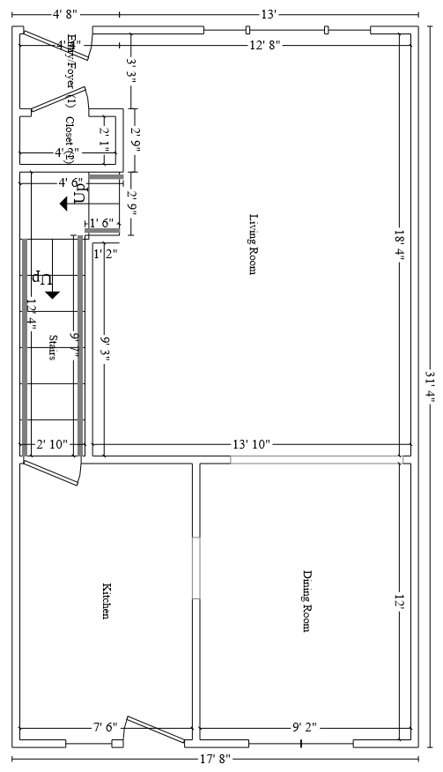
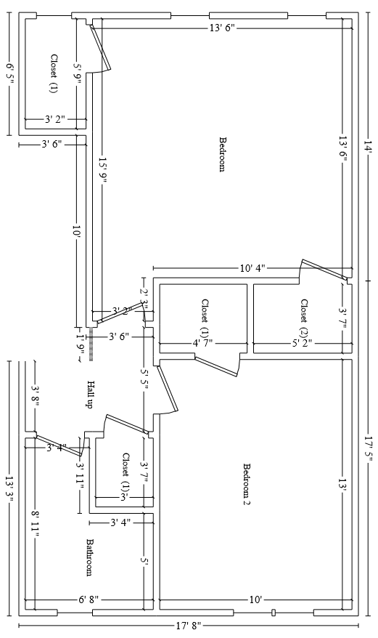
Salisbury Estates
*Please zoom in to see details.*
First Floor
Second Floor

Slide 18

Elbridge House
Kitchen
Dining Room
Bathroom
Room #5
Single
Bathroom
Room #9
Double
Room #4
Double
Room #3
Double
Room #8
Double
RA Room
#00
Lounge II
Room #7
Double
Lounge I
Alcove
Room #1
Single
Room #2
Double
Room #6
Double
Front Porch
First Floor
Second Floor
Third Floor
Elbridge Rd

Slide 19
Hackfeld House
Room #5
Double
Room #2
Single
Bathroom
Kitchen
Bathroom
Lounge
Room #4
Triple
RA Room
#1
Room #3
Double
Front Porch
First Floor
Second Floor
Hackfeld Rd

Slide 20
Schussler House
Back Porch
Laundry
Room #5
Single
Bath
Room #4
Single
Kitchen
Room #2
Double
Bath
RA Room
#1
Room #6
Double
Room #3
Double
Lounge
Front Porch
First Floor
Second Floor
Schussler Rd

